Slide 1
Media or Information Literacy Game
International School

Slide 2
Assignment
Develop a game that helps children in the age of 13 – 15 years old to improve their media or information literacy skills.

Slide 3
Media and Information Literacy skills are prerequisites for participation in 21st century life.
An international school for primary and secondary education wants to prepare her students for the information society but is not sure whether the focus should be on media literacy, information literacy or both.
What they do know is that a ‘serious game’ is the best way to develop such types of skills of their students.

Slide 4
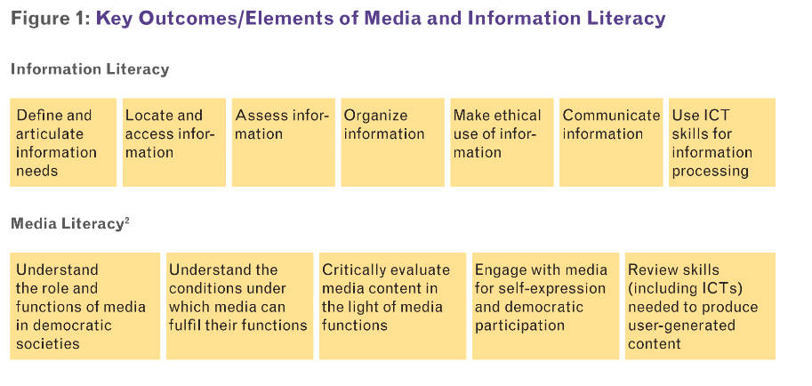
Unesco: Unified notion for two distinct areas

Slide 5
Deliverables
Game
Report with a description of the game and a motivation for all the decisions that you made during the development process
Test report
The two reports may be integrated in one research paper.

Slide 6
Questions to be negotiated
Will the game focus on Media Literacy, Information Literacy or both?
Age of the target group
How do we know that a game is a good instruction tool to improve Media and Information Literacy skills?
What types of MIL education is provided by the school until now?
How media or information literate are the children now?

